Slide 1
IoT SmartInternz Project
By Aadarsh Ashok

Slide 2
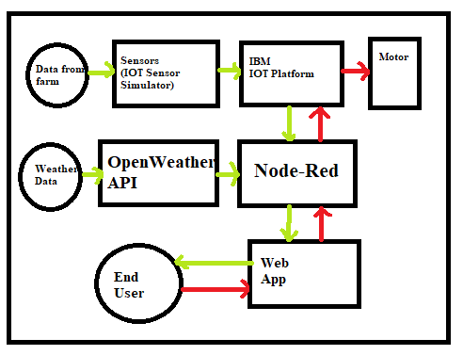

Slide 3
Explanation
On creating the IOT device on the IBM Watson IOT Platform, we have successfully connected it to the IOT Sensor Simulator, and have received details on the Temperature, Humidity and Soil Moisture, in real time. - We have connected the same to Node-Red and are able to successfully extract the aforementioned details, and can separate the properties based on their name. - We have also connected Openweather API to furnish the current weather report as well, that can provide even more information to the farmer, so he can take a well-informed decision on when to irrigate, accessible from any location.

Slide 4
Thank you.

